Slide 1

CS244a: An Introduction to Computer Networks
Final Review
Nick McKeown
Professor of Electrical Engineering
and Computer Science, Stanford University
nickm@stanford.edu
http://www.stanford.edu/~nickm

Slide 2
Outline
The Basics
Where next?
  Classes to take

Slide 3


Packet Switching
M/R
M/R
Host A
Host A
R1
R1
R2
R2
R3
R3
Host B
Host B
Breaking message into packets allows parallel transmission across all links, reducing end to end latency. It also prevents a link from being “hogged” for a long time by one message.

Slide 4
Packet Switching
Queueing Delay
Because the egress link is not necessarily free when a packet arrives, it may be queued in a buffer. If the network is busy, packets might have to wait a long time.
Host A
TRANSP1
Q2
R1
TRANSP2
PROP1
TRANSP3
R2
PROP2
TRANSP4
R3
PROP3
Host B
PROP4

Slide 5
A Simple deterministic model bytes or “fluid”
Cumulative number of bits that arrived up until time t.
A(t)
A(t)
Cumulative
number of bits
D(t)
Q(t)
μ
Service
process
μ
time
D(t)
Properties of A(t), D(t):
A(t), D(t) are non-decreasing
A(t) >= D(t)
Cumulative number of departed bits up until time t.

Slide 6
Simple Deterministic Model
Cumulative
number of bits
d(t)
A(t)
Q(t)
D(t)
time
Queue occupancy: Q(t) = A(t) - D(t).
Queueing delay, d(t), is the time spent in the queue by a bit that arrived at time t, and if the queue is served first-come-first-served (FCFS or FIFO)

Slide 7
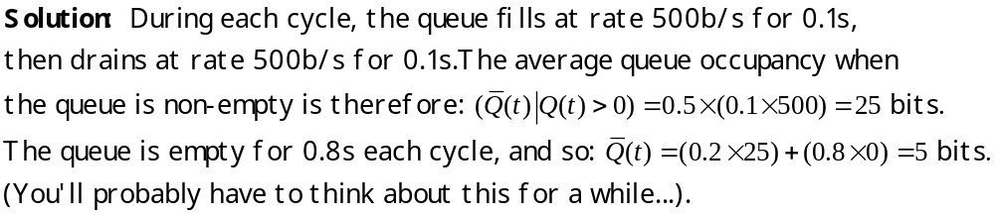
Example
Cumulative
number of bits
Q(t)
Example: Every second, a train of 100 bits arrive
at rate 1000b/s. The maximum departure rate is 500b/s.
What is the average queue occupancy?
d(t)
A(t)
100
D(t)
0.1s
0.2s
1.0s
time

Slide 8
Review of Basic Principles
Basic ideas:
  Packet switching, statistical multiplexing, deterministic models of queues.
Physical Layer:
  Channel capacity, encoding and clock recovery, elasticity buffers.
Link Layer:
  CSMA/CD
  Ethernet switching
Network Layer:
  Routing: Bellman-Ford, Dijkstra and multicast
  Addresses and lookups

Slide 9
Review of Basic Principles (2)
Transport Layer:
  Flow control, congestion control, retransmissions and sliding windows, congestion avoidance (RED).
Quality of Service:
  Fairness
  Guarantees, WFQ and leaky-buckets.

Slide 10
Outline
The Basics
Where next?
  Classes to take
What I will ask on the final

Slide 11
Classes to take
Networking classes (not all offered every year)
  CS244b: Distributed Systems (Spring)
  CS155: Computer and Network Security (Spring)
  EE384a: Network Protocols and Standards (Winter)
  EE384b: Multimedia Networking (Spring)
  EE384c: Wireless LANs (Spring)
  EE384m: Network Algorithms (Spring)
  EE384s: Network Arch. and Performance Engineering (Spring)
  EE384x,y: Packet Switch Architectures (Winter,Spring)
  CS344/EE384d: Build an Internet Router - Design Project (Spring)
  CS241: Advanced Topics in Internet Technologies (Spring)
Related
  CS255: Cryptography and Computer Security (Winter)
  Stats 116, EE178, EE278: Probability and random processes
  CS249: Object Oriented Modeling (Winter)
  EE376A: Information theory
Seminars
  Stanford Networking Seminar (http://netseminar.stanford.edu)
  “Clean Slate Design for the Internet” (http://cleanslate.stanford.edu)

Slide 12
Outline
The Basics
Where next?
  Classes to take

